Slide 1
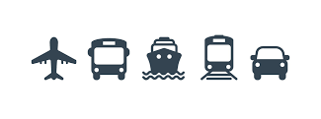
Transportation Inside Ayodhya

Slide 2
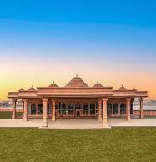
Travel By Air
Maharishi Valmiki International Airport, Ayodhya Dham was inaugurated by Prime Minister Narendra Modi on 30 December 2023, with flight operations beginning from 10 January 2024.
Spanning across an extensive area of 821 acres
First phase, a 65,000-square-feet terminal capable of handling 300 peak hour passengers.
Phase 1 of Ayodhya Airport was developed at a cost of over ₹1,450 crore
Phase 2 of Ayodhya Airport is in the design & engineering stage
It will involve construction of a 30,000 sq. m new terminal building capable of handling 3,200 peak hour passengers
The major flight service is from Indigo Airlines followed by spice jet and air india and akasa air
Other 2 nearby airports include - Gorakhpur Airport (GOK) is 118 km away and Amausi Airport, Lucknow is 125 km away from Ayodhya

Slide 3
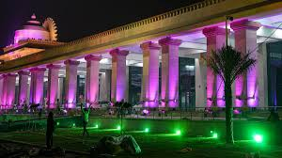
Travel by Train
Ayodhya Dham Junction Railway Station and Ayodhya Cantt Railway Station are the two railway junction stations in Ayodhya district.
Ayodhya Dham Junction Railway is just 1.8km from Shri Ram Janmabhoomi Temple, with a travel time of 7 mins to reach the temple.
Ayodhya Cantt Railway Station also known as Faizabad Railway Station is 9.5km from Shri Ram Janmabhoomi Temple, with a travel time of 25 mins to reach the temple.
The Indian Railways is running more than 200 Aastha special trains from various cities and tier 1 and tier 2 towns across India to Ayodhya after the Ram Temple consecration ceremony on January 22.
Two Amrit Bharat and six Vande Bharat Express trains launched by PM Narendra Modi, which will be operational to Ayodhya Junction

Slide 4
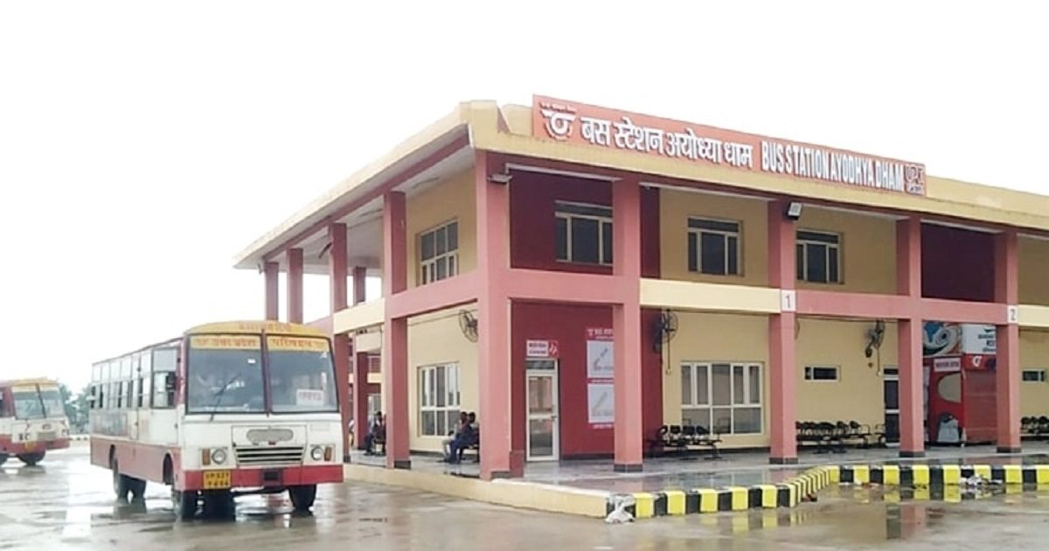
Travel By Bus
Ayodhya has a well-developed road network, and several state-run and private buses operate on routes connecting Ayodhya to major cities and towns.
Lucknow to Ayodhya - State Transport Buses: Uttar Pradesh State Road Transport Corporation (UPSRTC) operates regular buses from Lucknow to Ayodhya. The journey time is approximately 4-5 hours.
Varanasi to Ayodhya - Private Bus Services. The journey takes around 5-6 hours, depending on traffic.
Delhi to Ayodhya -Volvo Services: Several private operators run Volvo buses from Delhi to Ayodhya..
Omaxe Ltd. construct a state-of-the-art bus terminal in Ayodhya Dham, by covering a sprawling area of 36,426 square meters, construction cost of approximately ₹225 crore
The new bus terminal would be built on a 9 acre parcel of land behind the Ayodhya Dham Bus Station on the Lucknow Gorakhpur National Highway's Ayodhya bypass. The bus terminal would be built on the PPP model and would feature contemporary amenities found in airports.
150+ e-buses deployed in Ayodhya. They have been initiated on the Dharma Path and Ram Path.

Slide 5
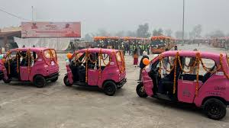
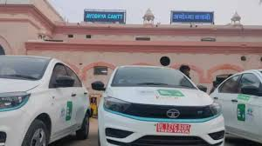
EV and Cab Services
200 EVs will be introduced in Ayodhya for local service and for travelers landing at the Ayodhya airport. 24 operational already.
All major transportation companies like Uber, Ola & Rapido have their services available in Ayodhya.
EV Golf car services also are available for devotees these EV’s are a ECO friendly four-wheeler e-vehicles with zero carbon emission with a seating capacity of four passengers.
650 e-carts, to be deployed till March in the first phase.
An e-cart service, has been operational in Ayodhya since the Deepotsav program last year. This service has a seating capacity for 6 passengers and mainly helps elderly devotees travel to Hanumangarhi and Shri Ram Janmabhoomi temple complex and other pilgrimage sites.
Wheelchairs will also be provided free of cost at the Ram temple for the elderly, divyangjans, and pregnant women

Slide 6
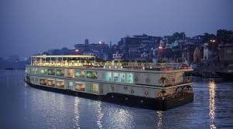
Boats & Ferries
Tourists will soon be able to hop on solar ferries to travel along the banks of Saryu river in Ayodhya.
The Ayodhya Development Authority (ADA) has floated bids to induct 10 solar ferries to take the tourists around the temple town.
The capacity of the ferries will range between six to 50 individuals.
The ferries will have a GPS navigation system and will be equipped with solar panels and state-of-the art lithium battery.
Two Electric catamaran boats and two jetties will be operated on the Saryu river in Ayodhya, to facilitate smooth movement of pilgrims from Guptar Ghat to Naya Ghat, the two riverbanks that are 15km apart
The Jatayu cruise service is likely to be launched in Saryu before Deepotsav, scheduled in the first week of November. Pilgrims and tourists to sail on the Saryu river in Ayodhya on a state-of-the-art luxury cruise ship. It can carry 70 passengers at once, will last between one and a half and two hours.

Slide 7
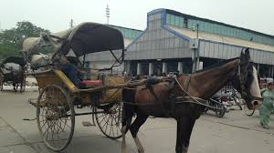
Tonga Service, CNG Autos and Tempos
Bhagwati baggi wale is said to be the last horse-cart driver in the town. He is keeping the tradition of tonga’s alive in Lord Ram’s birthplace.
CNG Tempos and Auto’s are also available for local travel inside the city.

Slide 8
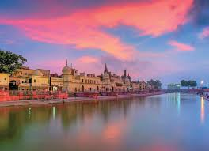
Thank You

