Slide 1
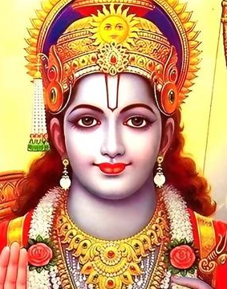
Significance of Lord Ram Globally

Slide 2
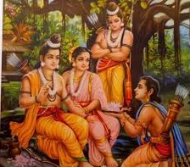
Lord Ram’s story and the Ramayana have left an indelible mark on diverse cultures and societies around the world. From inspiring literature and arts to shaping religious practices and moral frameworks, the global significance of Lord Ram transcends national and cultural boundaries, uniting people through shared narratives of virtue, duty, and righteousness.
Rama is especially important to Vaishnavism. He is the central figure of the ancient Hindu epic Ramayana, a text historically popular in the South Asian and Southeast Asian cultures. His ancient legends have attracted bhashya (commentaries) and extensive secondary literature and inspired performance arts.

Slide 3
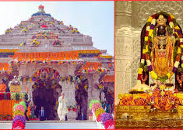
India
Lord Ram is a central figure in Indian culture, spirituality, and history. The Ramayana, composed by the sage Valmiki, is one of the two major Sanskrit epics of ancient Indian literature. It narrates the life of Prince Ram, his wife Sita, and his loyal companion Hanuman, focusing on Ram's exile, the abduction of Sita by Ravana, and her rescue.
Lord Ram is often considered an epitome of dharma (righteousness) and an ideal king. The concept of "Rama Rajya" symbolizes a just and prosperous society and has been invoked in political and social contexts to denote good governance

Slide 4
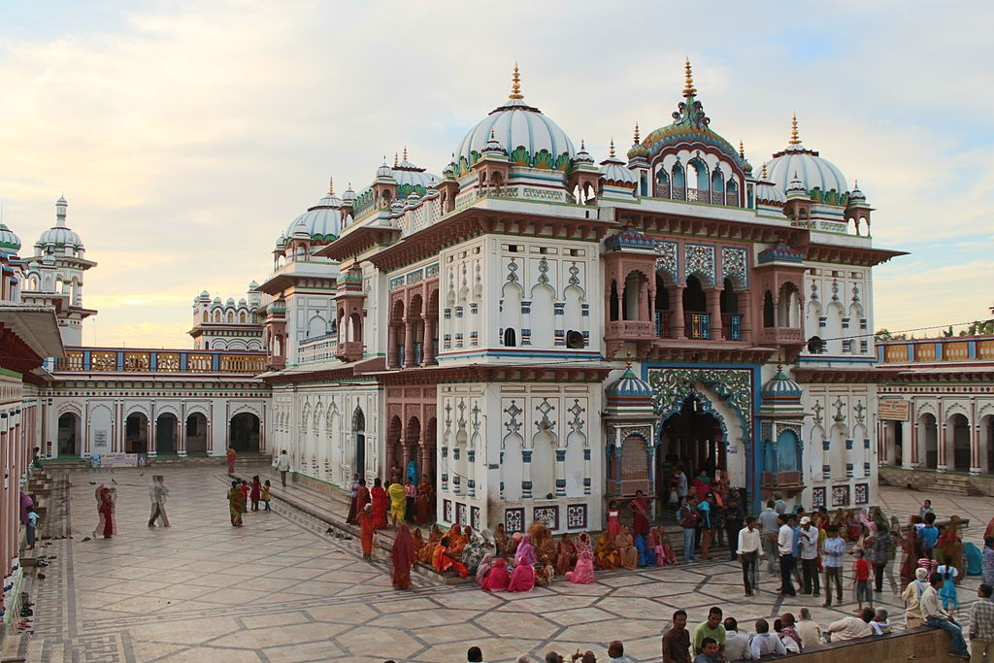
Nepal
Birthplace of Sita: Janakpur, believed to be the birthplace of Sita, is a significant pilgrimage site. The Janaki Mandir is an important temple where numerous festivals and rituals related to the Ramayana are celebrated.
The Ramayana's influence in Nepal extends to literature, folklore, and daily life, with various local adaptations and celebrations.

Slide 5
Sri Lanka
Ravana's Kingdom: Sri Lanka is historically connected to the Ramayana as the kingdom of Ravana. Locations such as the Sigiriya rock fortress, Ashok Vatika (Nuwara Eliya), and Munneswaram temple are linked to the epic.
These sites attract pilgrims and tourists, fostering a cultural and historical connection between Sri Lanka and the Ramayana narrative.

Slide 6
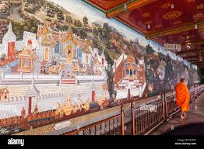
Thailand
Ramakien: The Thai adaptation of the Ramayana, called the Ramakien, integrates local culture and Buddhist elements. It is a central part of Thai literature and arts.
Murals depicting scenes from the Ramakien adorn the walls of the Grand Palace in Bangkok. Traditional Thai dance and theater performances often depict Ramakien stories.
The Ramayana or Ramakien is particularly appealing to the Thai people because it presents the image of an ideal king, Rama, who symbolizes the force of virtue or dharma while Thotsakan (Ravana) represents the force of evil. Eventually the force of good prevails.

Slide 7
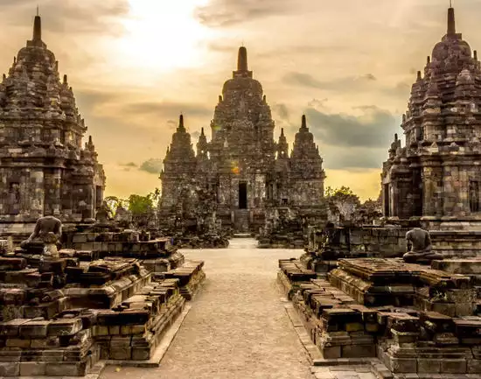
Indonesia
Wayang Kulit and Kecak: The Ramayana is a significant influence on Indonesian performing arts. Wayang Kulit, a traditional form of shadow puppetry, and Kecak, a Balinese dance drama, vividly portray the epic's tales.
The Prambanan temple complex, a UNESCO World Heritage site, features extensive bas-reliefs illustrating scenes from the Ramayana, highlighting the epic's importance in Indonesian culture.
Despite being a Muslim-majority country, the Ramayana's legacy reflects Indonesia's Hindu-Buddhist past, promoting cultural unity and historical awareness.

Slide 8
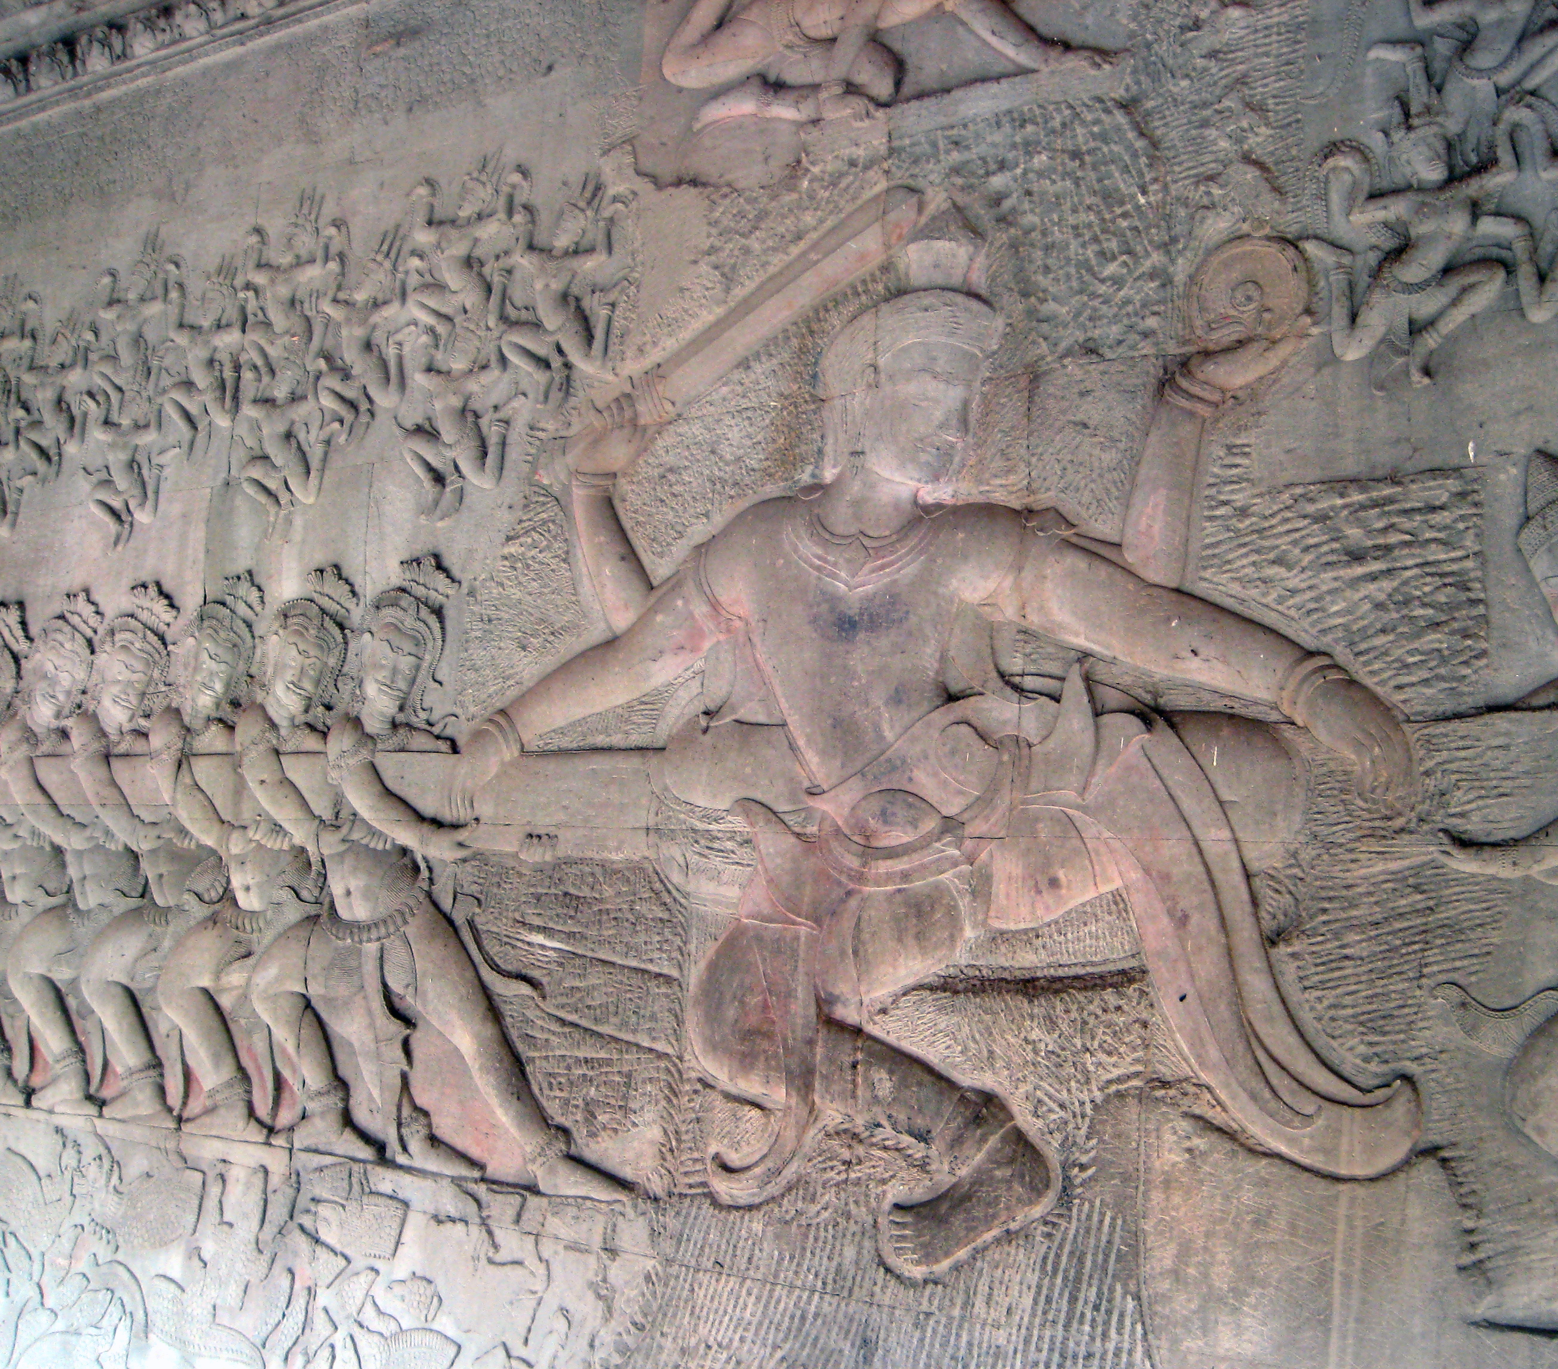
Cambodia
Reamker: The Khmer version of Ramayana bears the name Reamker (Ramakerti)-literally means "The Glory of Rama". Indeed, the story of Rama is present in both art and literature throughout the history of Cambodia. Cambodian Ramayana contains some incidents that could not find in Valmiki's Ramayana.
Reamker is central to Cambodian classical dance, literature, and sculpture.
The temple complex of Angkor Wat includes detailed bas-reliefs depicting scenes from the Reamker, showcasing the integration of Hindu epics into Cambodian history and art.

Slide 9
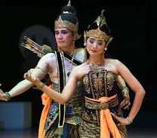
Malaysia
The Tamil community in Malaysia celebrates Ramayana-related festivals such as Diwali and Thaipusam, where episodes from the epic are recounted.
Hikayat Seri Rama is the Malay literary adaptation of the Hindu Ramayana epic in the form of a hikayat. The main story remains the same as the original Sanskrit version but some aspects of it were slightly modified to a local context such as the spelling and pronunciation of names.

Slide 10
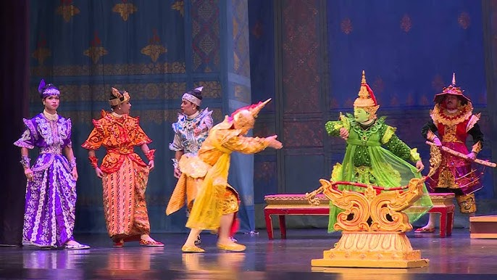
Myanmar (Burma)
Yama Zatdaw: The Burmese adaptation of the Ramayana, Yama Zatdaw, is performed in traditional Burmese theater and dance. It is an integral part of Myanmar's cultural history and is celebrated in various festivals.
It also has components of Burmese culture, folklore, and Buddhism, making it distinct from the original Indian version.
The epic has influenced Burmese literature and moral teachings, contributing to the cultural and educational landscape

Slide 11
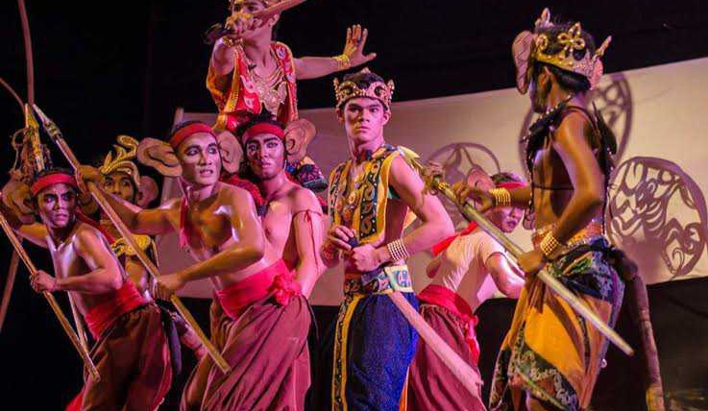
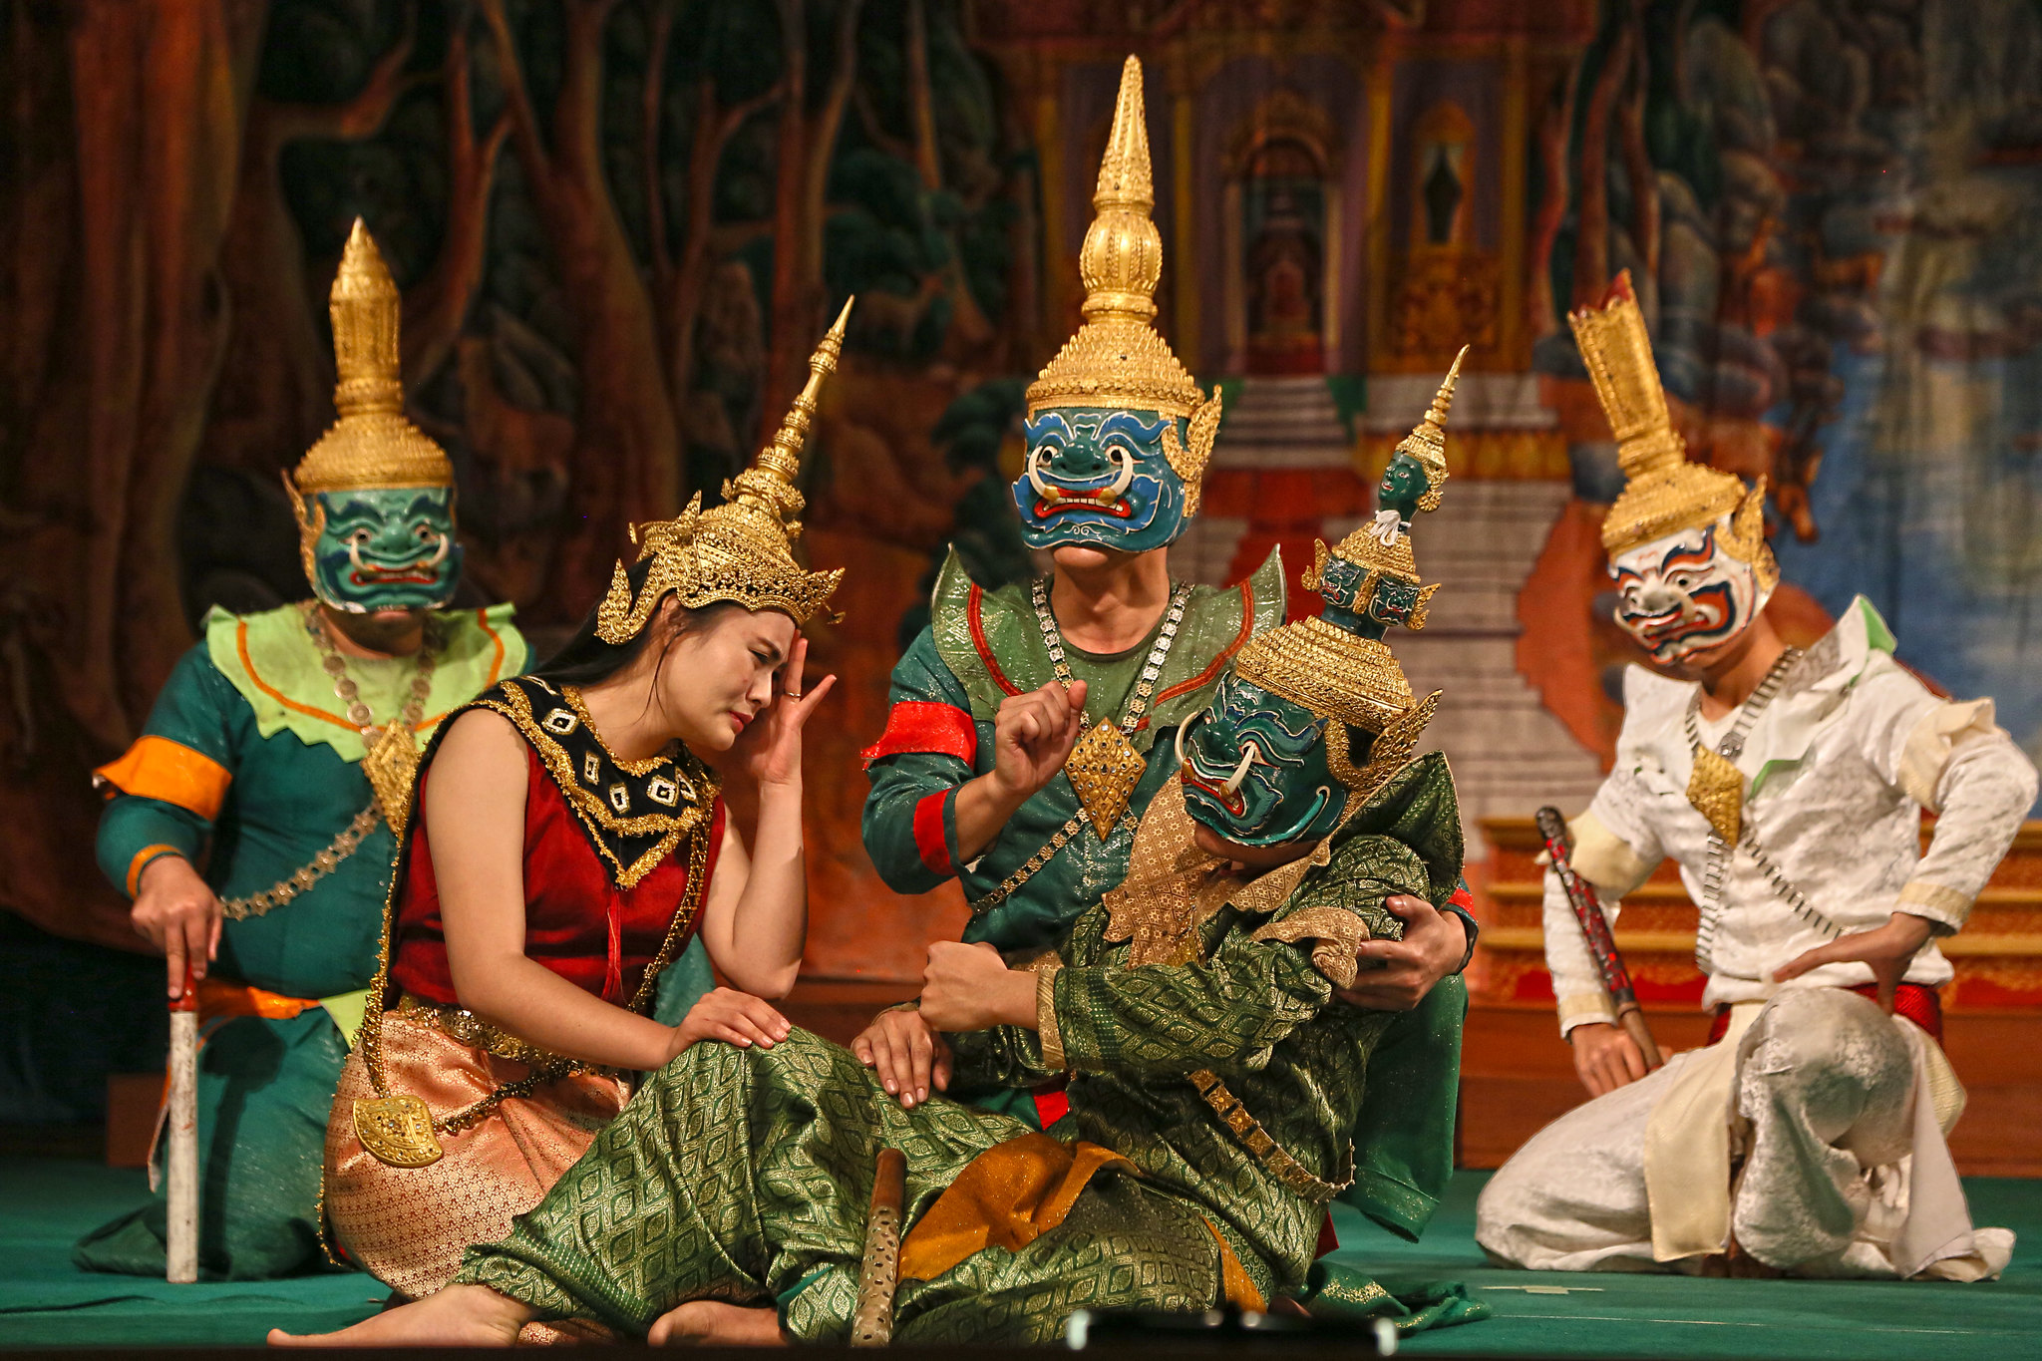
Philippines & Laos
While Philippines is predominantly a Catholic country, regions with historical Hindu-Buddhist heritage, such as Mindanao, have folklore and traditions influenced by the Ramayana. The epic’s stories are occasionally reflected in local legends and traditional performances.
Phra Lak Phra Lam: The Laotian version of the Ramayana, Phra Lak Phra Lam, is a significant literary and cultural work. It is performed in traditional dance and theater, influencing Lao cultural expressions. Various festivals celebrate the stories of Phra Lak Phra Lam, integrating the Ramayana into Lao religious and cultural practices.

Slide 12
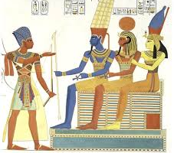
Egypt & Turkey
Rama of Ayodhya belonged to the Suryavansha or the solar dynasty. Interestingly, the Pharoah Ramses of Egypt also belonged to the Solar dynasty and also took on the name Ram.
The original Egyptian name of the Pharaohs, in their hieroglyphic language, devoid of vowels, was R.M.S which sounds like Ra Ma Sa, similar to Rama.
The name of the 8th Turkish King, Dasharatha, bears an uncanny similarity to the name of Rama’s father, Dasharatha. The other kings also have the prefix or suffix of the sun in their name, reflecting a possible connection to the Solar dynasty or Suryavansh.

Slide 13
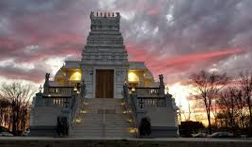
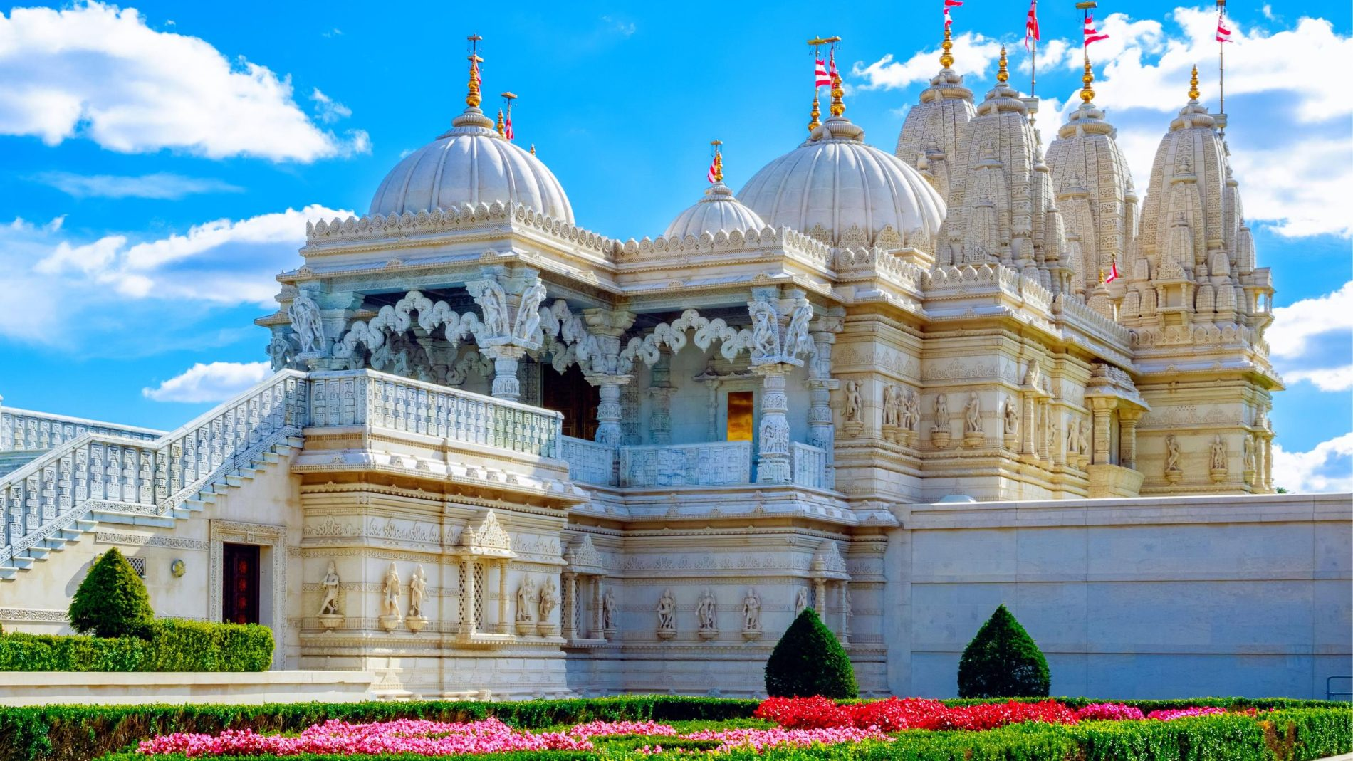
Global Hindu Diaspora
United States, Canada, UK, and Caribbean Nations: The Hindu diaspora maintains the cultural and religious traditions related to the Ramayana. Temples dedicated to Lord Ram, like the Bharatiya Temple in Pennsylvania and the Shri Ram Mandir in London, serve as cultural hubs.
Organizations and community groups conduct cultural programs, festivals, and educational activities to celebrate and propagate the Ramayana, ensuring its relevance across generations.

Slide 14
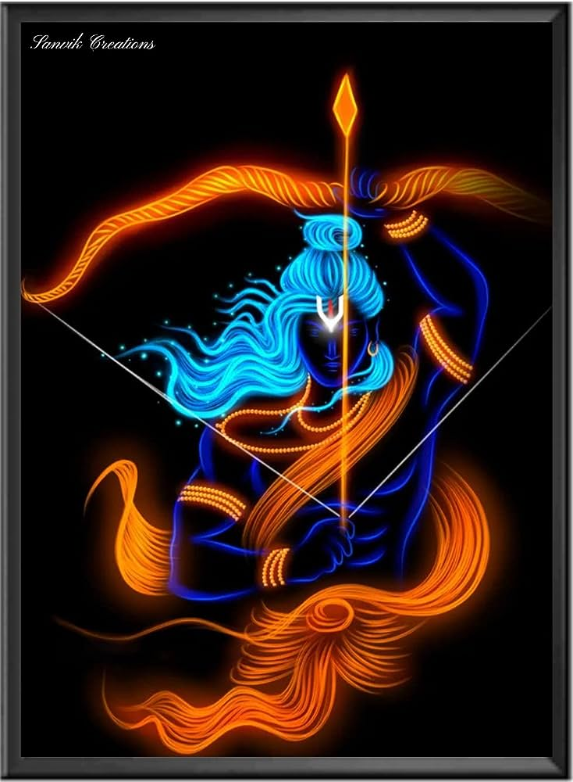
Conclusion
Lord Ram’s global significance is immense, as his story and the Ramayana continue to inspire and influence various cultures and societies. From art and literature to religious practices and ethical teachings, the epic of Ramayana serves as a cultural bridge, fostering connections and shared values across different nations and communities. The widespread veneration and adaptation of Lord Ram's story highlight its universal appeal and enduring legacy

